Slide 1
Optimizing Head and Neck Radiation Outcomes While Reducing Side Effects
Thomas P. Sollecito, DMD, FDS RCSEd
Professor and Chair of Oral Medicine
University of Pennsylvania
School of Dental Medicine
Division Chief of Oral Medicine
Penn Medicine

Slide 2
Objectives
Understand risk factors and epidemiology for oral cavity and oropharyngeal cancer
Discuss surgical and non-surgical treatment strategies of head and neck cancer
Describe the complications associated with head and neck cancer therapy
To understand the difference between acute and chronic oral complications associated with cancer therapies
To understand the incidence of acute and chronic oral complications from cancer therapies
To understand the impact of key risk factors on management of oral complications associated with cancer therapies

Slide 3
Oral Cavity and Pharynx CANCER STATISTICS
Estimated New Cases in 2025: 59,660
2.9% of all new cancer cases in USA
Estimated Deaths in 2025: 12,770
2.1% of all cancer deaths
5-year survival rate 69.5% (2015-2021)
Median age of diagnosis at age 65
Male : Female 3:1
Early detection = Improved survival
SEER Cancer Stat Facts: Oral Cavity and Pharynx Cancer. National Cancer Institute. Bethesda, MD, https://seer .cancer.gov/statfacts/html/oralcav.html
Accessed Nov 14, 2025

Slide 4
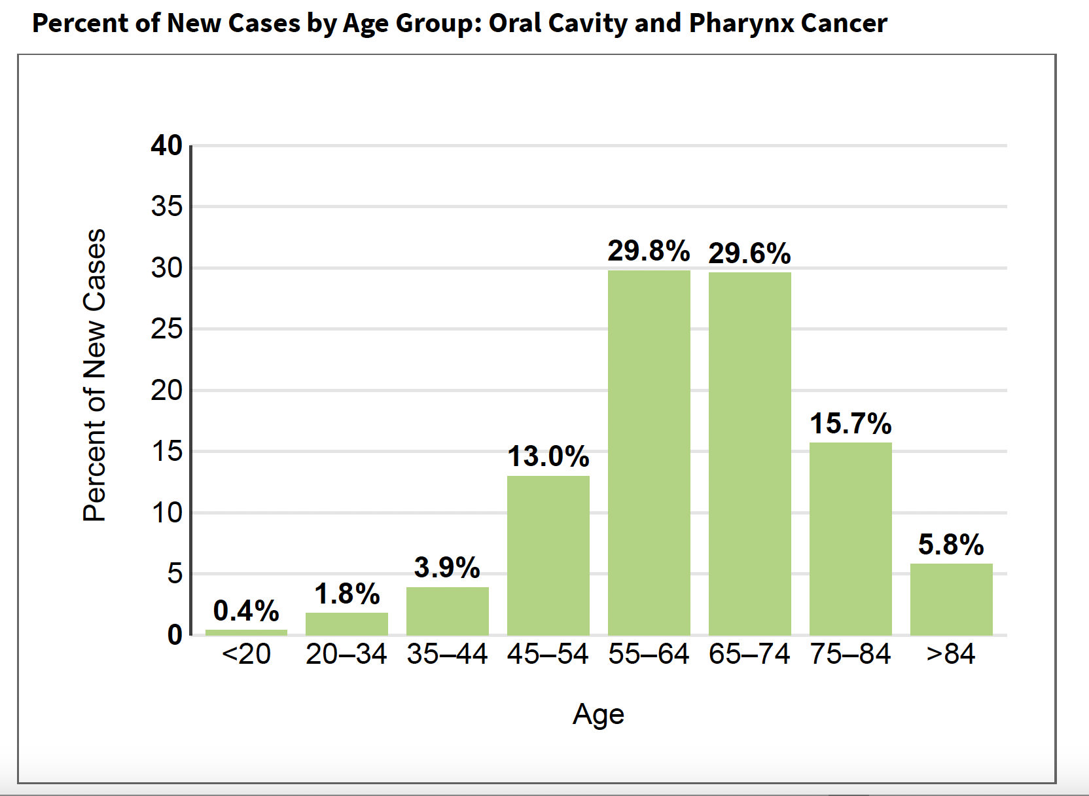
SEER 21 2018–2022, All Races, Both Sexes Accessed Nov 14th, 2025

Slide 5
Risk Factors for Oral Cancer
Using tobacco and alcohol, especially combined use (risks for heavy smokers and drinkers (2) are increased more than 30-fold)
Using smokeless tobacco, including snuff and chewing tobacco
Chewing betel quid, areca nut, gutka and paan
Being immunologically compromised (e.g., after bone-marrow transplantation)
Increased age
Fanconi’s anemia/Li-Fraumeni syndrome/Dyskeratosis congenita
Plummer-Vinson syndrome (mucosal atrophy, dysphagia, iron-deficiency anemia).
History of prior OP Cancer
Having a human papilloma virus infection, especially type 16
Smoking marijuana
Being exposed to environmental tobacco smoke
Having low fruit and vegetable intake
UV Light - Lip Cancer

Slide 6
Distinguishing Oral and Pharyngeal Cancers
Traditional Risk Factors
HPV
No known risk factors
Oral Cavity Cancer (OCSSC) v. Oropharyngeal Cancer (OPSCC)

Slide 7
Incidence Rates
Overall, OCSCC incidence rates (IR) for most sites, including the lip, gingiva, and floor of mouth have decreased in the U.S.
Consistent with declines in the prevalence of the major risk factors—tobacco and alcohol use
IR for OPSCC (base of tongue, tonsil, soft palate, and pharyngeal wall) significantly increased particularly in white men
Increase in OPSCC is due to human papillomavirus (HPV)
Chaturvedi et al., JCO 2008

Slide 8
Incidence Rates
IR for oral tongue SCC (anterior two-thirds of the tongue) increasing in young males and females
causes of this increase remain
Patel et al., JCO 2011 and Tota et al., Oral Oncol. 2017

Slide 9
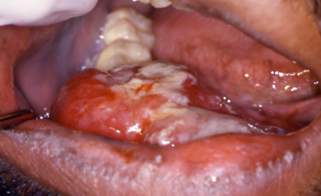
Oral Cancer

Slide 10
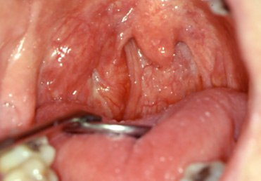
Oral Pharyngeal Cancer

Slide 11
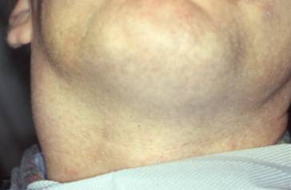

Slide 12
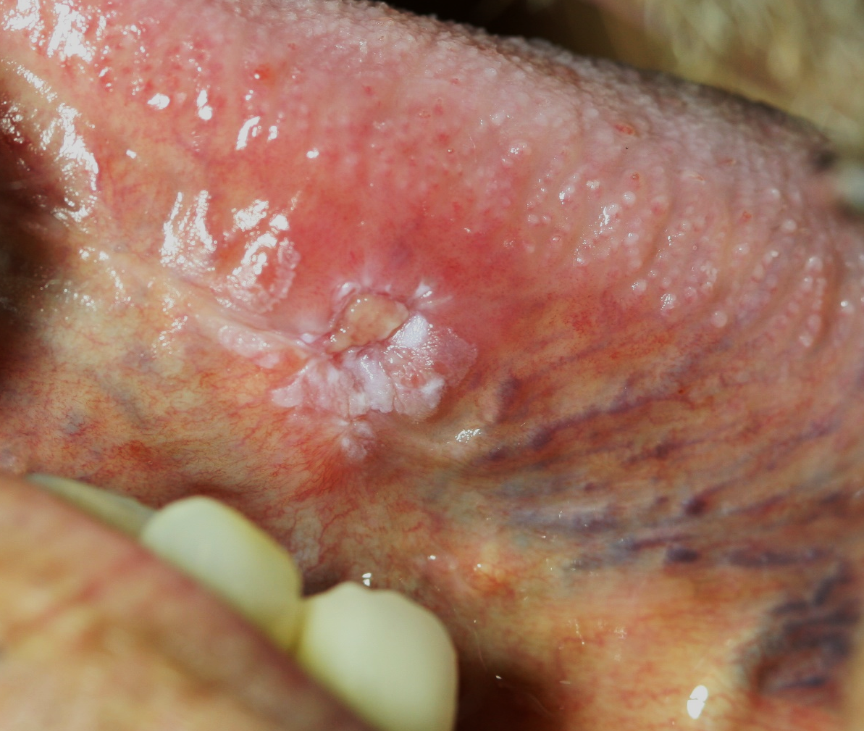
Lateral Tongue Cancer No Risk Factors

Slide 13
Symptoms
Symptoms
Precancerous & early cancerous lesions are not often associated with symptoms
Late stage cancer might be associated with dysphagia, pain, speech alteration or an oral/neck swelling

Slide 14
Management of Oral Cancer
Usually treated by surgery, and/or radiation with or without chemotherapy, solely or in combination
Surgical excision is often the treatment of choice for accessible well-defined tumors
Transoral robotic surgery TORS is an improved surgical approach resulting in fewer side effects
Radiotherapy could be an effective alternative to surgery but most often is an adjunct in regional control
Chemotherapy (neoadjuvant) has been shown to improve regional control and long-term survival
Since patient’s that have had a history of prior oral cavity cancer or oropharyngeal cancer are at high risk for developing another, lifelong follow up with particular attention to the clinical oral and head and neck exam is warranted

Slide 15
Complications Based on Treatment Modality
Complications to surgery include disfigurement, pain, dysphagia, trismus and speech impairment
Complications to chemotherapy include mucositis, pain, neuropathy and dysgeusia
Complications to radiotherapy include mucositis, xerostomia/salivary dysfunction, infections, dysphagia/odynophagia, dysgeusia, trismus, dental disease, potential for osteoradionecrosis

Slide 16
Cancer Therapy and Toxicities
Cancer Treatment Modalities | % of patients with oral complications
Head and neck RT | 100
High Dose Chemotherapy + HSCT | Nearly 100
Chemotherapy (primary) | 40

Slide 17
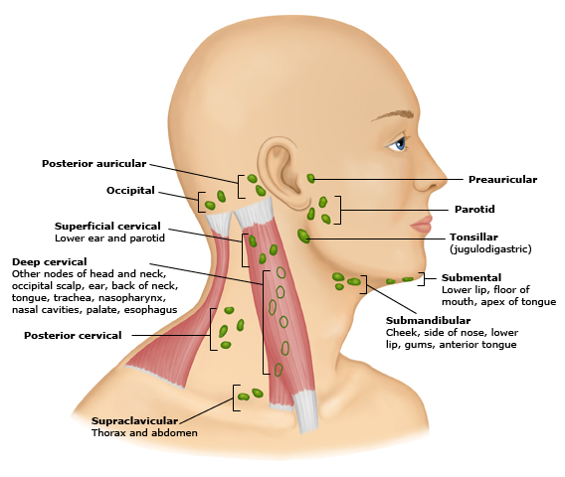
External Beam Therapy
Usually begins 6 wks post surgical resection
Field of radiation
Location/extent of primary tumor
Lymph node(s)
Metastasis
Rapidly dividing cells are
more sensitive
Notes:
2500 cGy Bone marrow, lymphocytes, GI tract, testes, ovaries
2500 - 5000 cGy Oral mucosa, salivary glands, growing bone and cartilage, collagen
>5000 cGy Mature bone and cartilage, skeletal muscle, nerve tissue

Slide 18
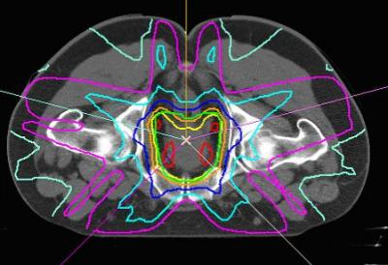
Intensity Modulated Radiation Therapy (IMRT)
Divides each treatment field into multiple segments
Multiple radiation beams from different directions.
Gives distinct dose to each segment
High doses of radiation directly to tumor
Limits tissue area radiated
Lessen side effects and complications

Slide 19
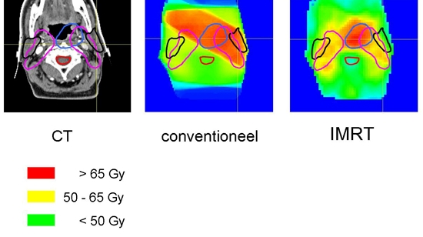
IMRT Advantage
Conventional

Slide 20
Fractionation
Squamous cell carcinoma
Total radiation dose =6,000 cGy - 7,500 cGy
Given in divided doses
1,000cGy/week
200 cGy per day
5 days a week
Accelerated hyperfractionation
120 cGy-160 cGy twice a day
10-14 day break after 4,000 cGy for healing

Slide 21
Radiation Causes IRREVERSIBLE Changes
↓ vascularity (mandible > maxilla)
Fibrosis of the microvasculature
Decreased ability of bone to heal and remodel
↓ in salivary production
Inflammation and occlusion of the ducts
↑ damage to the acini with ↓ serous secretion
Vascular and inflammatory fibrosis of the parenchyma

Slide 22
Acute Oral Complications
Mucositis
Xerostomia
Oral Pain
Dysphagia
Microbial Infections
Dysgeusia

Slide 23
Late Oral Complications
Xerostomia/Salivary Hypofunction
Trismus
Dental Disease
Soft Tissue Necrosis
Bone Necrosis
Medication-related osteonecrosis of the jaw (MRONJ)
Osteoradionecrosis (ORN)

Slide 24
Oral Mucositis Incidence
Standard chemotherapy regimens
Non-Hodgkin lymphoma and breast cancer (standard doxorubicin and –taxane based therapies with grade 3 and 4 mucositis: 3–10%)
HDC + HSCT
Oral mucositis incidence 80% - 100% for any grade
30-50% Grade 3 and 4 oral mucositis without TBI
>60% Grade 3 and 4 oral mucositis with TBI
RT for head and neck cancer
Near 100%
Lalla R, et al. Cancer 2014;120:1453–61

Slide 25
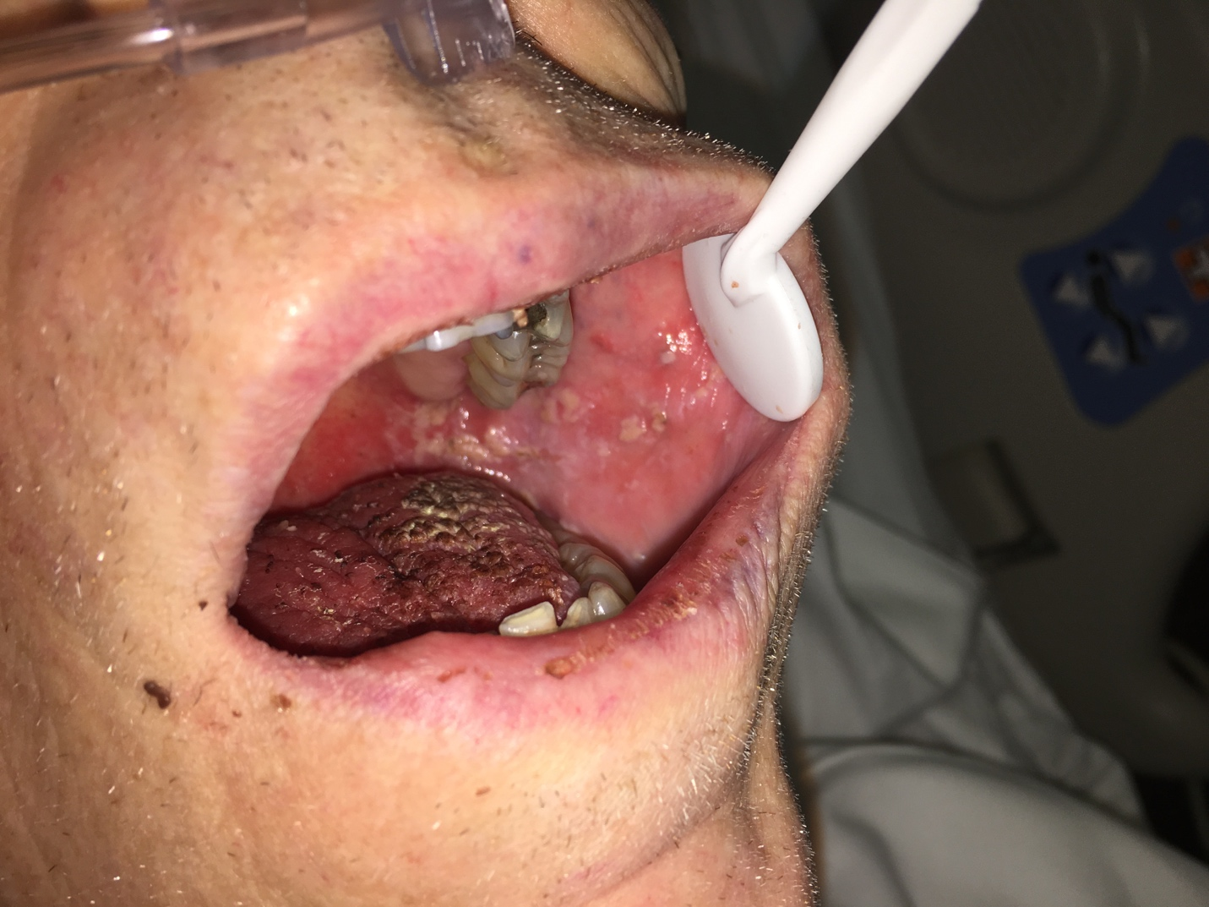
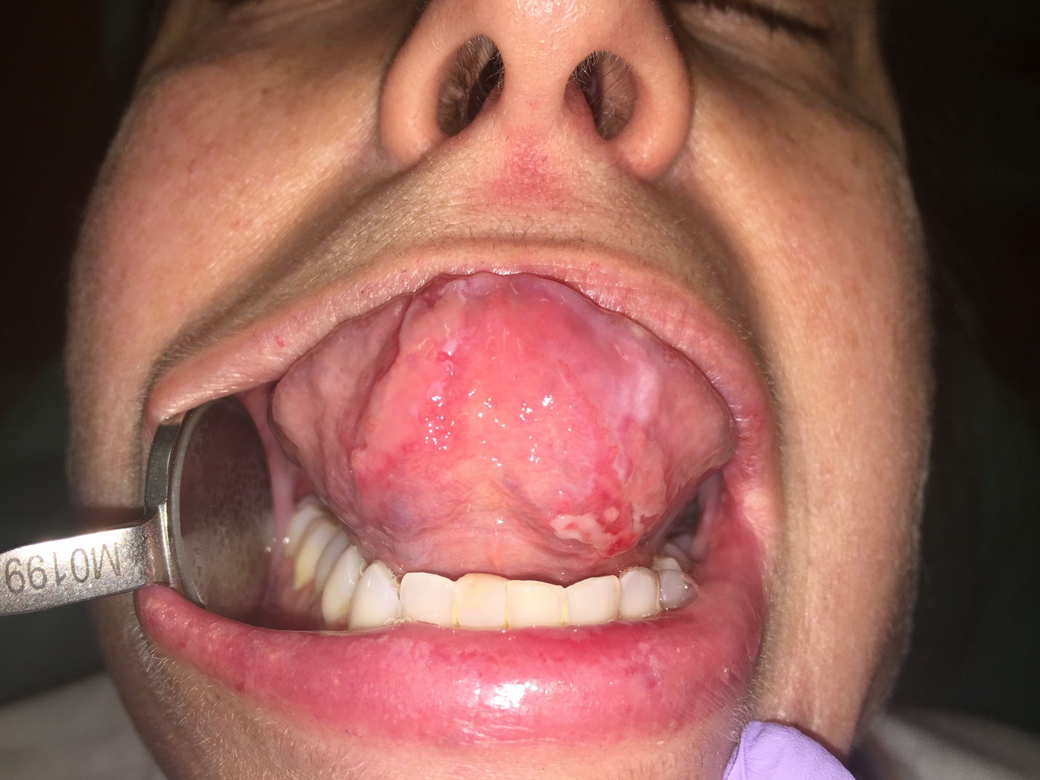
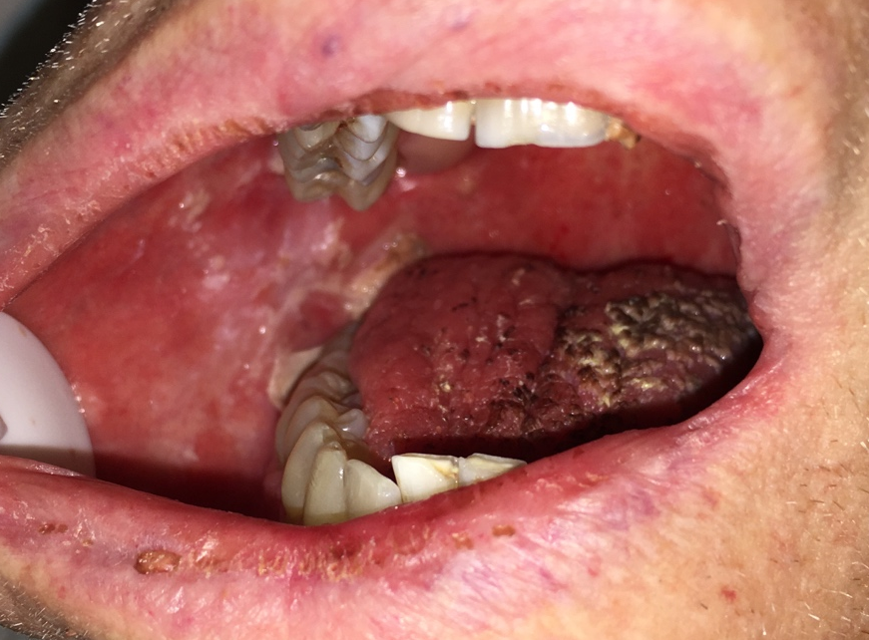
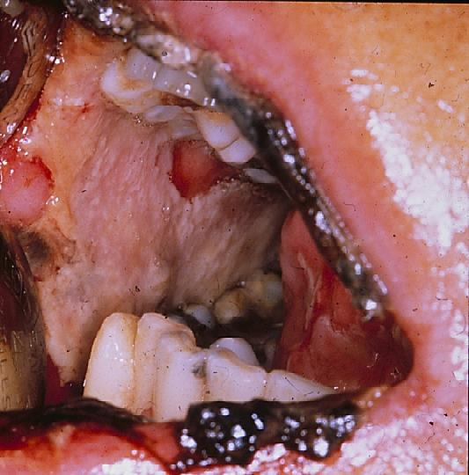
WHO Oral Mucositis Scale
- Grade 0: No changes
- Grade 1: Soreness/erythema - Grade 2: + ulceration / solid foods
- Grade 3: / liquid diet - Grade 4: / alimentation not possible

Slide 26
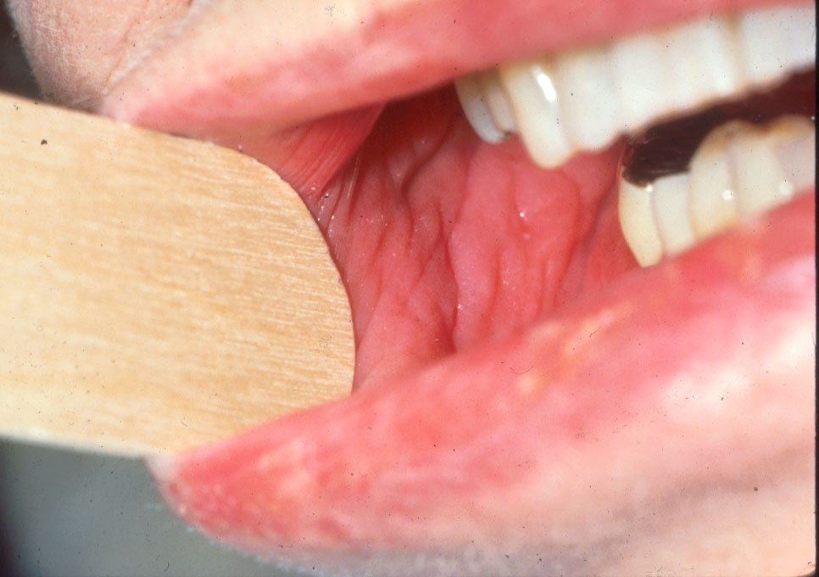
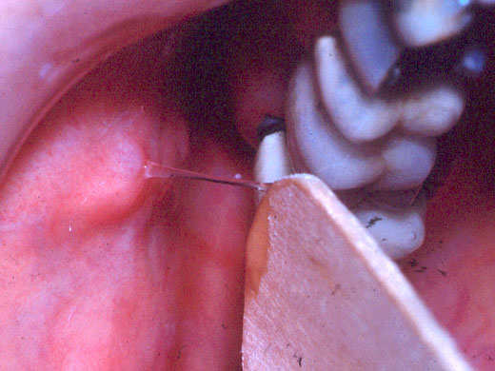
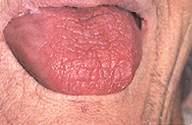

Slide 27
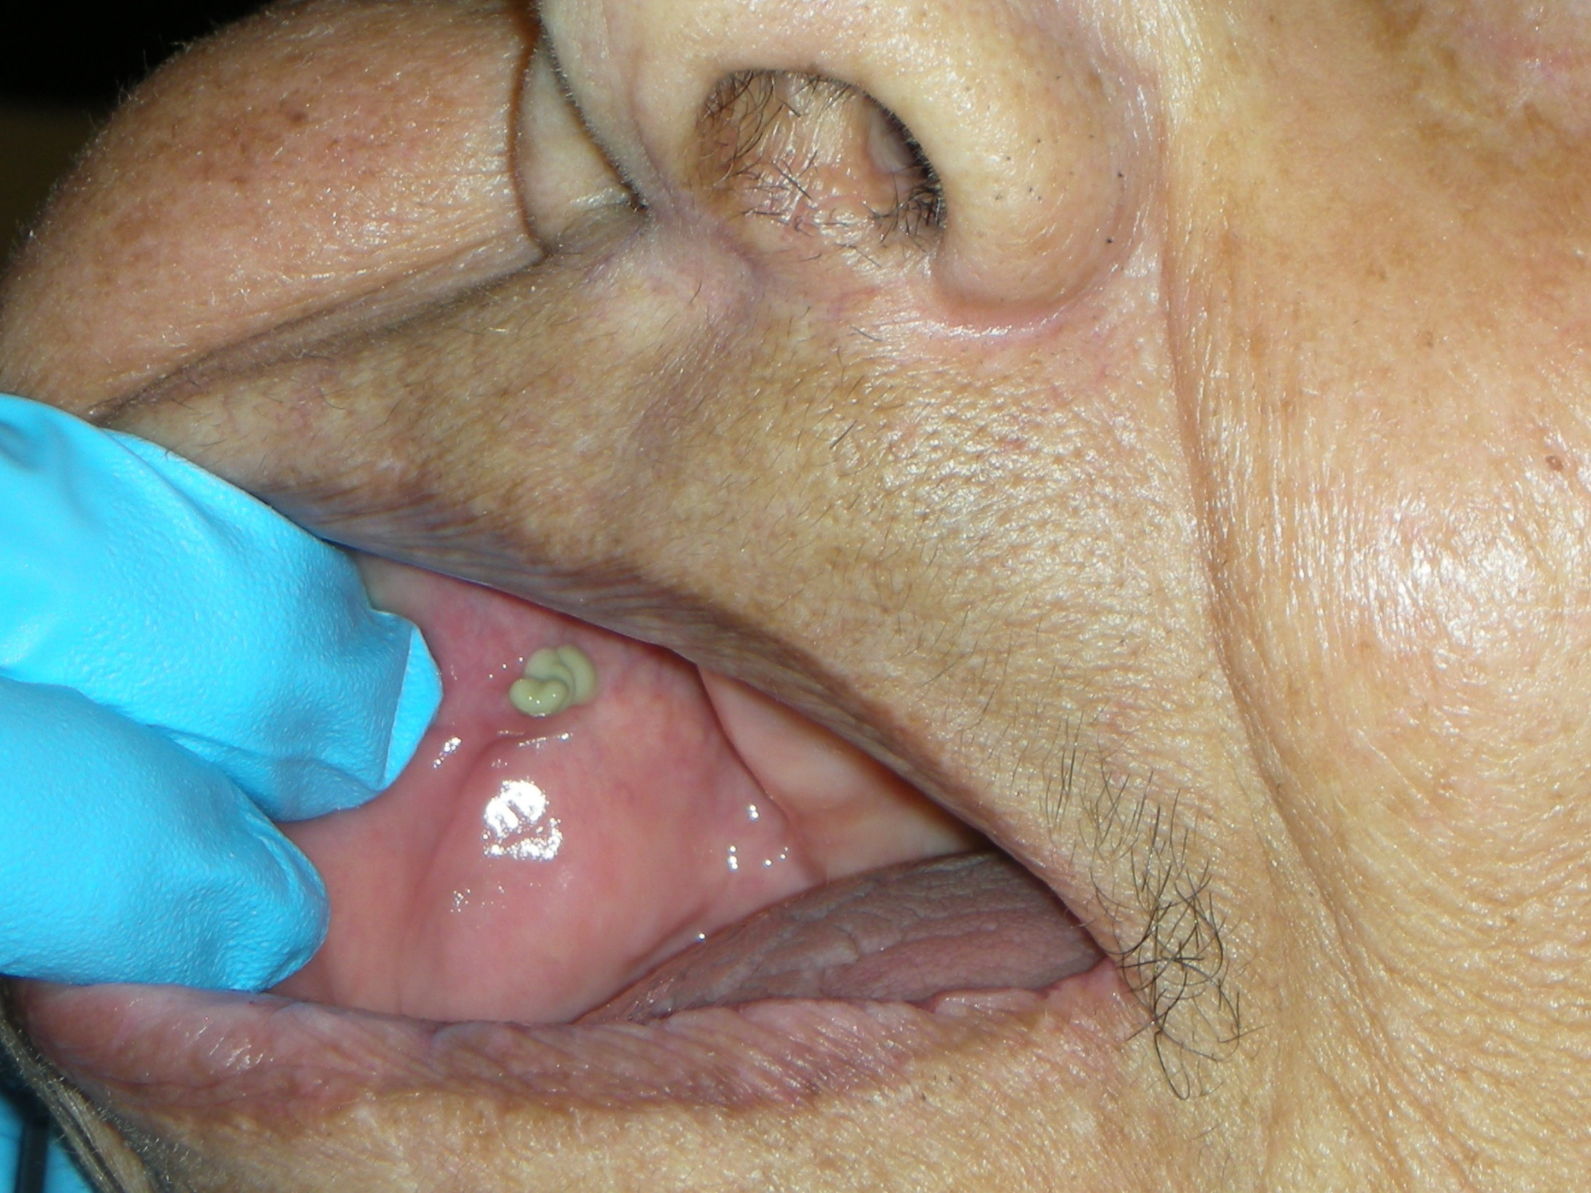

Slide 28
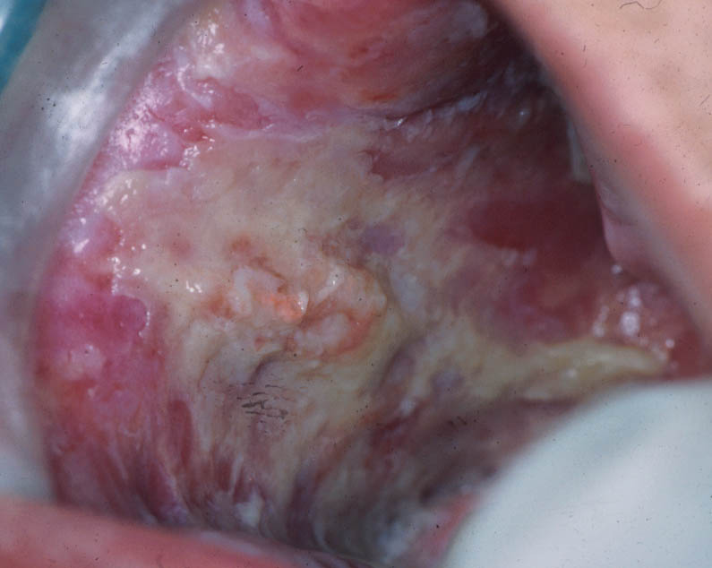
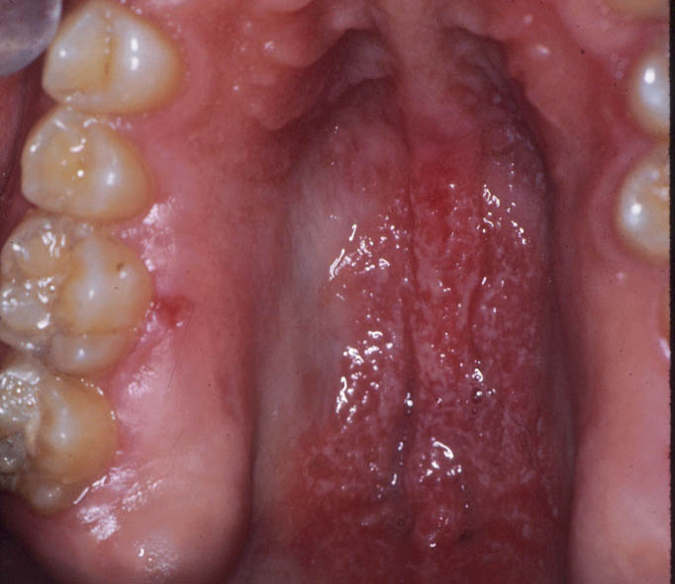
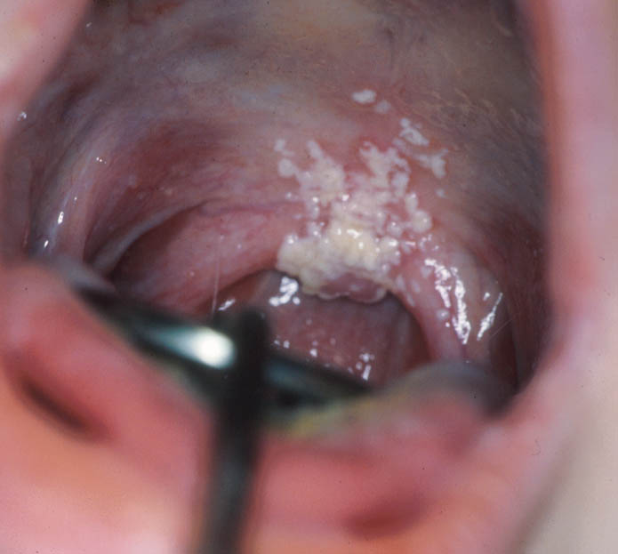
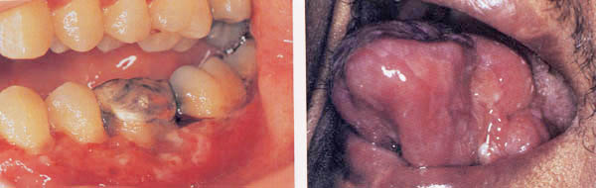
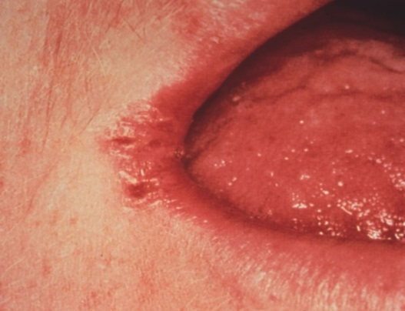
Microbial Infection - Fungal
Etiology/Appearance
Candidiasis
Pseudomembranous
Erythematous
Hyperplastic
Angular Cheilitis
Deep Fungal Infection
Solitary Lesion

Slide 29
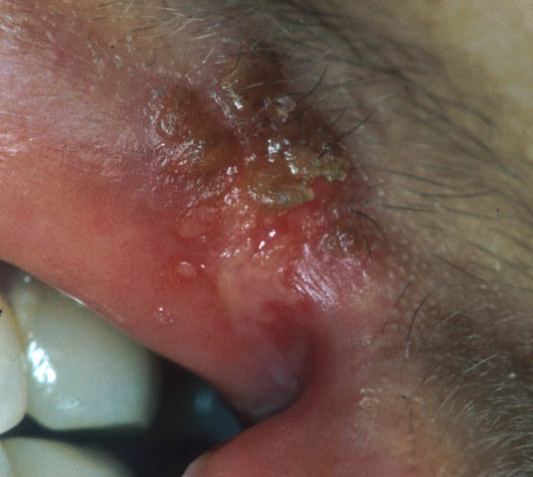
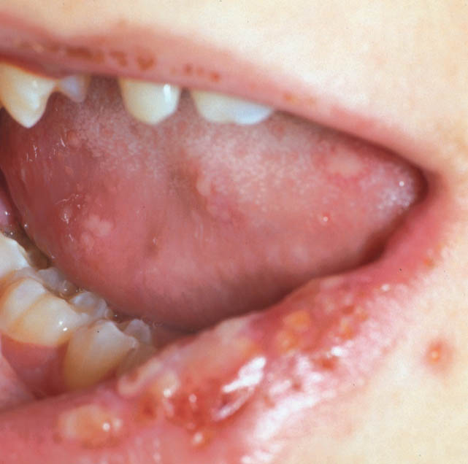
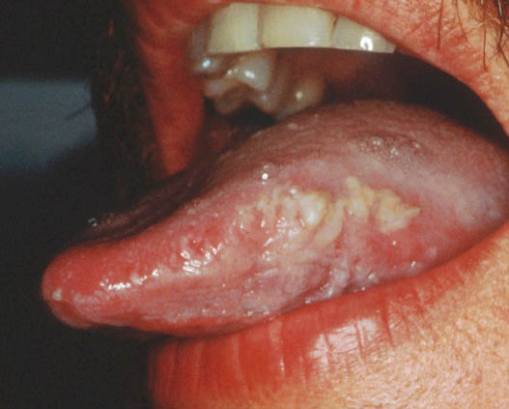
Microbial Infection - Viral
Etiology/Appearance
Herpes Simplex Virus
Other Herpesviruses
VZV
EBV
CMV

Slide 30
Osteoradionecrosis
ORN is characterized by a nonhealing area of exposed mandibular and maxillary bone of at least 6 months duration in a patient who has been treated with radiation therapy (RT) for cancer.

Slide 31
Trismus
Trismus is defined as the tonic contraction of the muscles of mastication and results in a limited ability to open the mouth. This has been associated with radiotherapy (RT) to the temporomandibular joint and muscles of mastication.

Slide 32
Clinical Registry of Dental Outcomes in Head and Neck Cancer Patients (ORARAD)
Multi-center prospective cohort study
Baseline visit prior to RT, then 6, 12, 18 and 24 months post RT
Inclusion Criteria
≥ 18 years
Head and neck squamous cell carcinoma (SCC) or salivary gland cancer (SGC) receiving curative radiation therapy (RT)
OR
Non-SCC, non-SGC of the head and neck expected to receive at least 4500 cGy
At least 1 natural tooth after completion of pre-RT dental extraction

Slide 33
OraRad
Brigham and Women’s Hospital
University of Connecticut Health Center
New York University College of Dentistry
University of Pennsylvania School of Dental Medicine
University of North Carolina at Chapel Hill
Atrium Health, Carolinas Medical Center, Charlotte, NC
University of Minnesota, Division of Biostatistics

Slide 34
Main outcomes
Measure 2-year changes in dental caries and periodontal disease, and 2-year rates of tooth loss, after modern RT regimens, and test risk factors for caries increment, progression of periodontal disease, and tooth loss.
Measure 6-month and 18-month changes in stimulated whole salivary flow after modern RT regimens and assess risk factors for decreased salivary flow.
Measure the incidence of exposed intraoral bone after modern RT regimens and assess risk factors for exposed intraoral bone.

Slide 35
Secondary outcomes
Incidence of post-extraction complications
Two-year change in mouth opening in mm
Two year use of fluoride to prevent new caries
Two-year chronic oral mucositis incidence
Two year changes in RT-specific quality of life measures
Two-year change in pain scores

Slide 36
 | Total (n=572) | BWH (n=158) | CMC (n=104) | UNC (n=31) | NYU (n=80) | UCONN (n=53) | UPENN (n=146)
Age (years) | 58.3 | 59.8 | 57.8 | 56.4 | 58.8 | 57.2 | 57.5
Male Sex | 440 (77%) | 124 (78%) | 77 (74%) | 22 (71%) | 54 (68%) | 44 (83%) | 119 (82%)
Type of Cancer:
SCC | 469 (82%) | 132 (84%) | 88 (85%) | 27 (87%) | 58 (73%) | 44 (83%) | 120 (82%)
SGC | 66 (12%) | 15 (9%) | 10 (10%) | 4 (13%) | 11 (14%) | 7 (13%) | 19 (13%)
NonSCC/ NonSGC | 37 (6%) | 11 (7%) | 6 (6%) | 0 (0%) | 11 (14%) | 2 (4%) | 7 (5%)

Slide 37
“CONSORT” FLOW DIAGRAM
Recruited n=1,792
Not interested/Too busy n=650
Less than 1 tooth to remain n=180
Too ill n=62
Moving/Not in area n=74
Other n=178
Screened n=648
No eligible cancer n=2
History of prior RT n=4
Not willing to participate n=2
Will not comply n=5
Will not have 1 tooth n=4
Will not have RT n=4
Does not want to continue n=12
Did not sign release n=1
Eligible for Baseline Visit n=614
Did not attend baseline visit n=35
Panoramic radiograph not avail n=2
Baseline Visit Completed n=577
Will not have RT n=1
No longer available n=4
Eligible post RT n=572
Died n=7
Withdrew n=1
6 Month Followup Visit
Attended n=471
Died n=21
Withdrew n=2
12 Month Followup Visit
Attended n=429
Died n=16
Withdrew n=0
18 Month Followup Visit
Attended n=395
Died n=18
Withdrew n=2
24 Month Followup Visit
Attended n=422

Slide 38
Salivary Hypofunction
Stimulated salivary flow collected at:
Baseline
6 mo*
18 mo*
Radiation dosimetric information collated from each patient’s radiotherapy plan
Dose (mean dose) delivered to critical salivary structures
Right and left parotid gland (Entire cohort)
Right and left submandibular gland (Penn only)
Oral cavity (surrogate for sublingual and minor salivary glands (Penn only)
*if missed allowed to collect at next follow up appointment

Slide 39
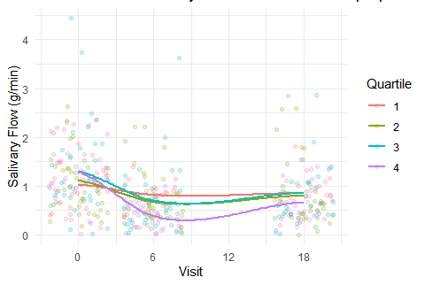
Correlation between dose to salivary glands and salivary flow
Average dose to salivary glands (which we defined as parotids, submandibular, and oral cavity), is directly correlated with salivary flow.
Dose to the salivary gland is categorized based on quartiles: quartile 1≤1978 (cGy), quartile 2>1978 and ≤2530.25 (cGy), quartile 3 >2530.25 and ≤ 3491 (cGy), and quartile 4 > 3491(cGy).
Recommendation: if possible, attempt to maintain average dose delivered to salivary glands to 20 Gy or below.
Lin A, Helgeson ES, Treister NS, Schmidt BL, Patton LL, Elting LS, Lalla RV, Brennan MT, Sollecito TP. The impact of head and neck radiotherapy on salivary flow and quality of life: Results of the ORARAD study. Oral Oncol. 2022 Apr;127:105783

Slide 40
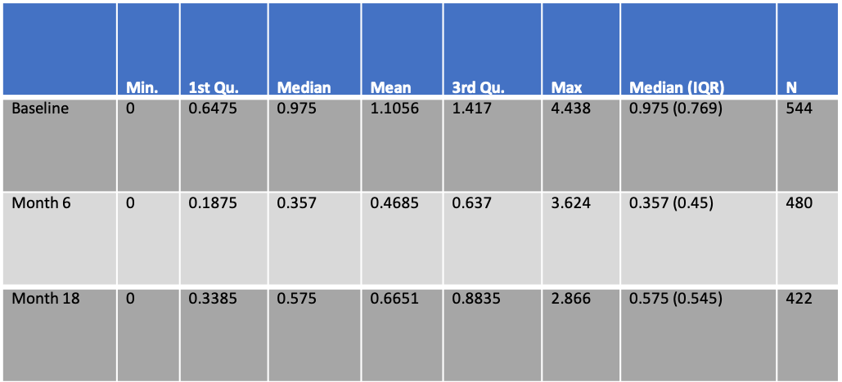
RT decreases salivary flow, but there is partial recovery during f/u from 6mo to 18mo

Slide 41
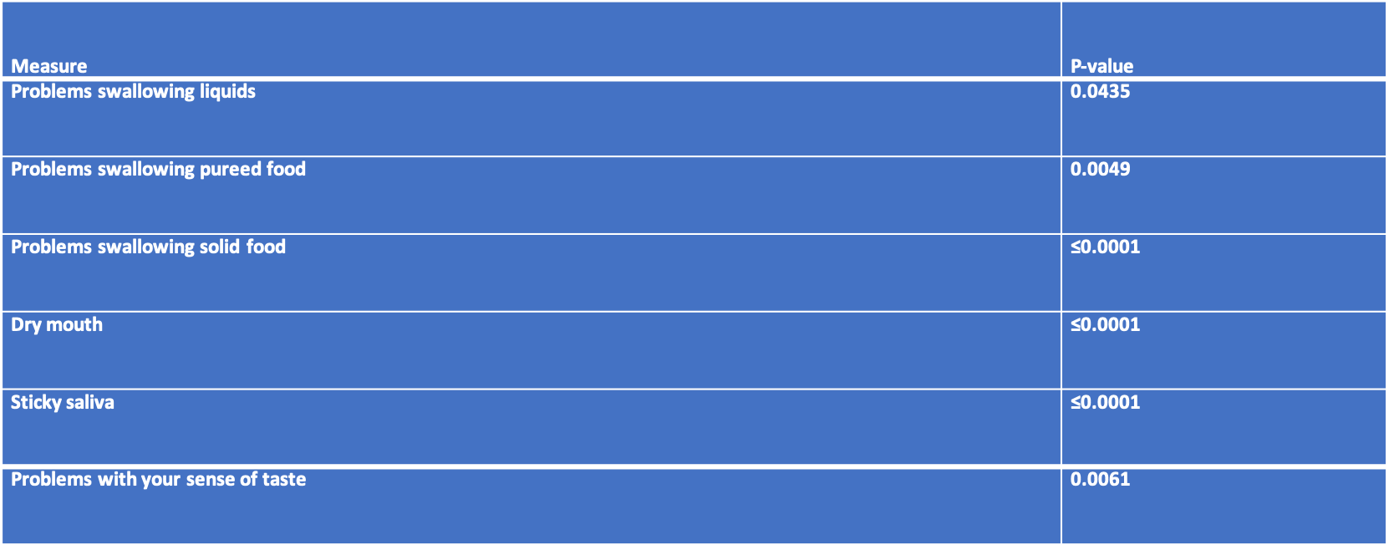
Association between salivary flow and change in EORTC measures

Slide 42
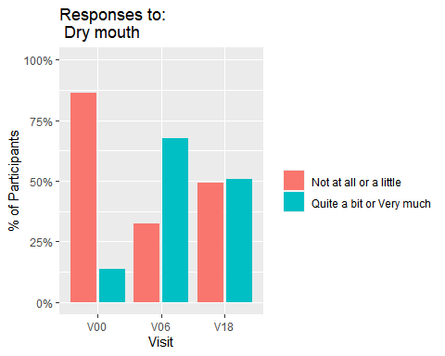
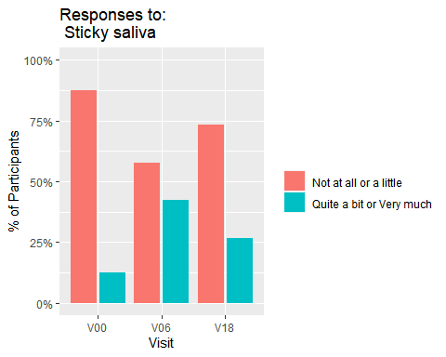
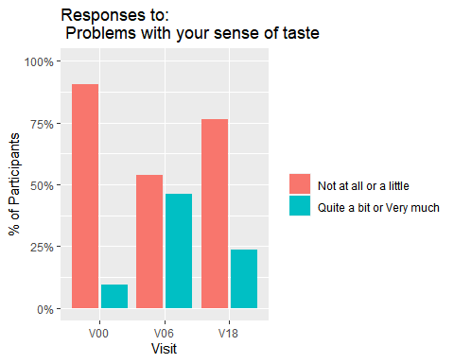
QoL IMPROVEMENT
Several EORTC QOL measures (dry mouth, sticky saliva, and taste) significantly improved during f/u (6mo to 18 mo, p<0.001). Demonstrates that patient reported outcomes can partially recover and improve during f/u

Slide 43
Additional Findings
Salivary Flow by RT type: (IMRT w/ Image Guidance (n=453) > 90% subjects)
Proton (30) Vs. IMRT w/ IG: NO STATISTICALLY SIG DIFFERENCES
3D Conformal (14) Vs IMRT w/ IG: STATISTICALLY SIG DIFFERENCES BL to 18 mo (less decrease in salivary flow in 3D Conformal) Spurious finding due to selection bias
IMRT w/ Vs. w/o IG (47): MARGINALLY STATISTICALLY SIG DIFFERENCES
B/L vs unilateral RT to primary site: STATISTICALLY SIG DIFFERENCES
Tumor site: STATISTICALLY SIG DIFFERENCES Oropharynx and Oral Cavity greater decrease in salivary flow than larynx (*smaller volume).
Chemotherapy/No chemotherapy:
Biologics NO STATISTICALLY SIG DIFFERENCES
Conventional chemotherapy (348): STATISTICALLY SIG DIFFERENCES Radio sensitizer ie biologically more effective OR Cancers with Chemo are usually More advanced stage and larger volume
Also followed with partial recovery from 6mo to 18mo

Slide 44
Salivary Hypofunction Conclusions
RT dose is directly correlated to salivary flow
Attempt to maintain average dose delivered to salivary glands to 20 Gy or below
Salivary flow initially decreases with a partial recovery by 18 months
Salivary flow impacts the QoL of patients undergoing RT
QoL measures significantly improve BUT not a return to baseline

Slide 45
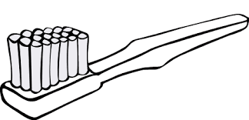
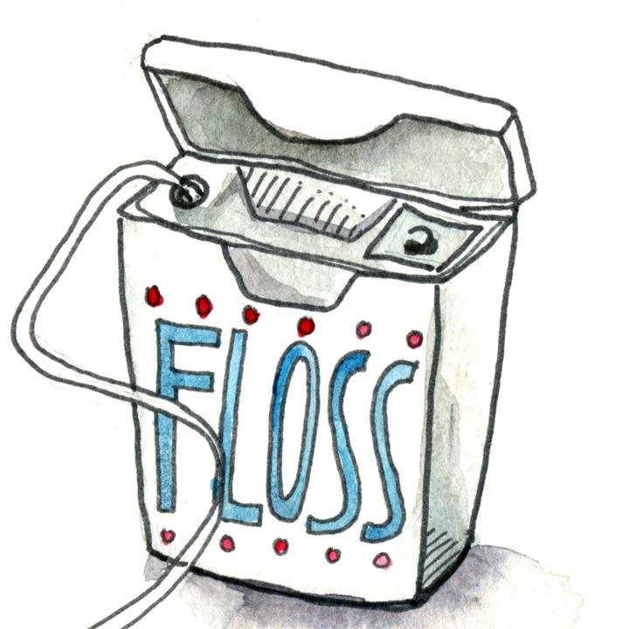
Definition of Daily Oral Hygiene Compliance
+

Slide 46

Definition of Daily Fluoride Compliance
OR

Slide 47
Compliance by Site
 | All Sites | BWH | CMC | UNC | NYU | UConn | UPenn
OH Compliant - n (%)
Baseline | 242 (42%) | 66 (42%) | 53 (51%) | 7 (23%) | 34 (42%) | 14 (26%) | 68 (47%)
6 Months | 234 (49%) | 67 (53%) | 42 (56%) | 9 (30%) | 25 (40%) | 16 (34%) | 75 (57%)
12 Months | 201 (49%) | 62 (54%) | 32 (53%) | 9 (36%) | 32 (53%) | 12 (29%) | 54 (50%)
18 Months | 166 (50%) | 55 (56%) | 25 (52%) | 5 (38%) | 20 (43%) | 11 (30%) | 50 (57%)
24 Months | 141 (49%) | 48 (61%) | 20 (45%) | 1 (100%) | 16 (46%) | 6 (18%) | 50 (54%)
During All F/U Visits | 182 (35%) | 55 (38%) | 25 (31%) | 9 (30%) | 25 (35%) | 8 (17%) | 60 (43%)
FL Compliant - n (%)
Baseline | 156 (27%) | 38 (24%) | 25 (24%) | 7 (23%) | 8 (10%) | 8 (15%) | 70 (48%)
6 Months | 229 (49%) | 61 (48%) | 32 (43%) | 14 (47%) | 20 (32%) | 12 (26%) | 90 (68%)
12 Months | 205 (50%) | 65 (57%) | 24 (40%) | 8 (32%) | 21 (35%) | 10 (25%) | 77 (71%)
18 Months | 159 (48%) | 54 (55%) | 19 (40%) | 5 (38%) | 12 (28%) | 9 (25%) | 60 (69%)
24 Months | 143 (50%) | 42 (53%) | 21 (48%) | 1 (100%) | 5 (15%) | 9 (26%) | 65 (71%)
During All F/U Visits | 167 (32%) | 46 (32%) | 17 (21%) | 9 (30%) | 12 (17%) | 5 (10%) | 78 (56%)

Slide 48
OH Follow-up compliant vs. OH Follow-up non-compliant: predicting FU compliance
Education (higher)
Sex (female)
Smoking
Current Alcohol Use
Dental Insurance (Y)
Dental check-up in past 12 mo. (Y)
BL teeth
Pre-RT dental extractions
Cancer surgery completed (Y)
Primary site of RT
Trismus at BL
Trismus during FU
Difficulty opening mouth wide (1-4)
A little
Not at all
Quite a bit
Very much
BL and FU pain scores
No Feeding tube
Lim J, Helgeson ES, Lalla RV, Sollecito TP, Treister NS, Schmidt BL, Patton LL, Lin A, Milas Z, Brennan MT. Factors associated with oral hygiene compliance in patients treated with radiation therapy for head and neck cancer. J Am Dent Assoc. 2024 Mar 7.
Notes:
1 to 3 52% decrease in compliance

Slide 49



Tooth Loss and Compliance
OH compliant at baseline visit (n=222: 43%)
OH non-compliant at baseline visit (n=294: 57%)
OH compliant during follow-up (n=182: 35%) | OH non-compliant during follow-up (n=334: 65%)
136 (61%) | 86 (39%)
46 (16%) | 248 (84%)
Notes:
Green Thumb did the best

Slide 50
Risk Factors for Tooth Loss
HNC patients with fewer teeth at baseline were more likely to lose teeth during follow-up and…
People who did not comply with brushing and flossing at baseline and during follow-up.
Lalla RV, Hodges JS, Treister NS, Sollecito TP, Schmidt BL, Patton LL, Lin A, Brennan MT. Tooth-level predictors of tooth loss and exposed bone after radiation therapy for head and neck cancer. J Am Dent Assoc. 2023 Jun;154(6):519-528.e4.

Slide 51
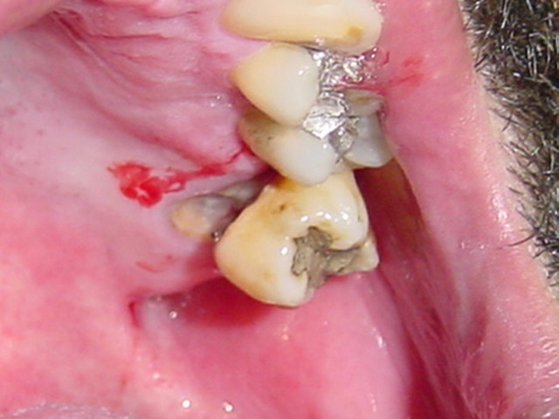
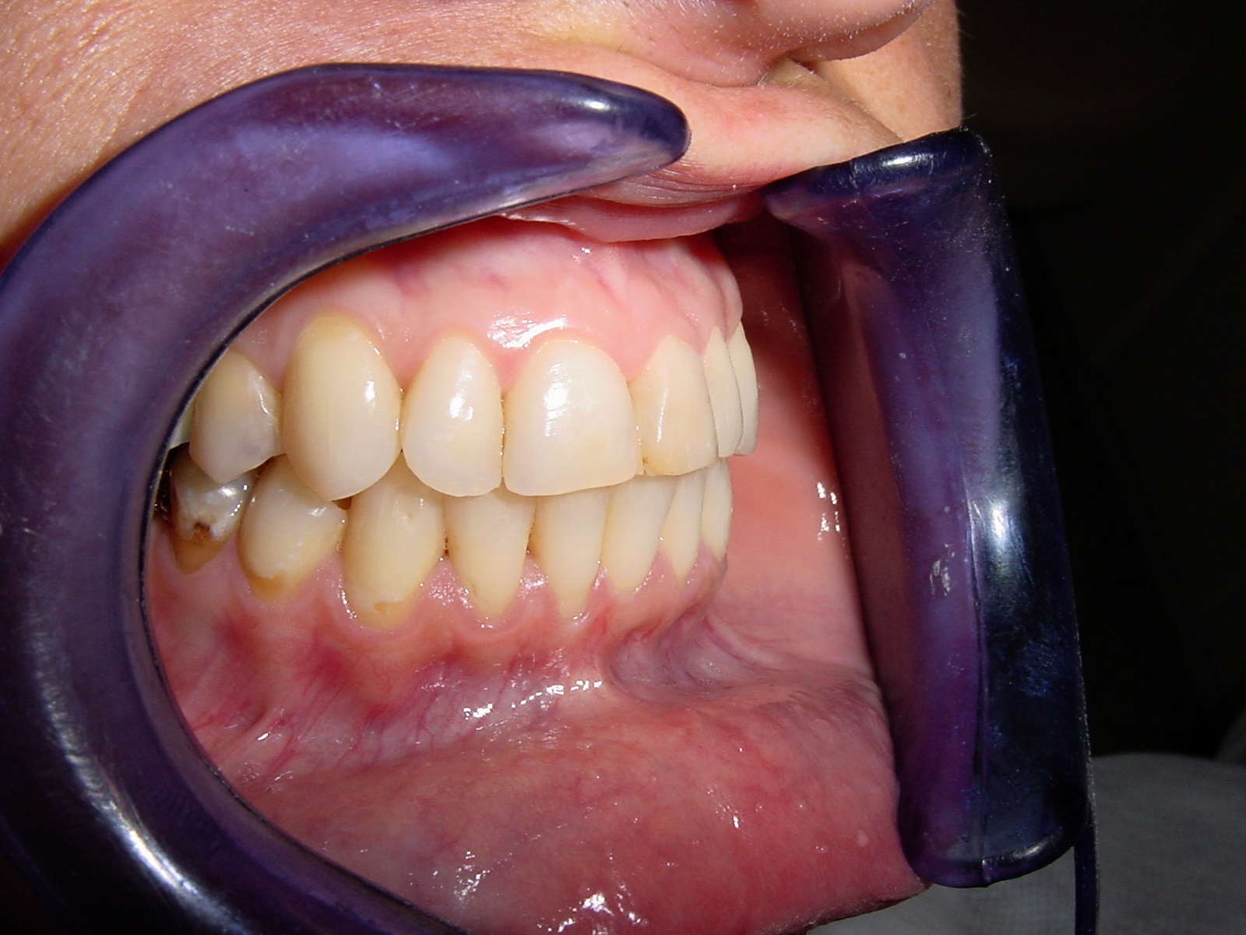
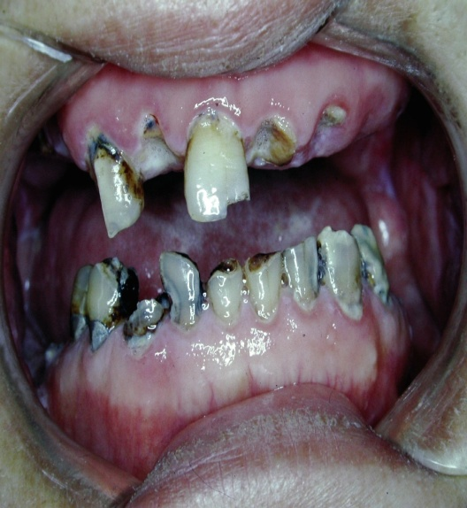
Dental Caries

Slide 52
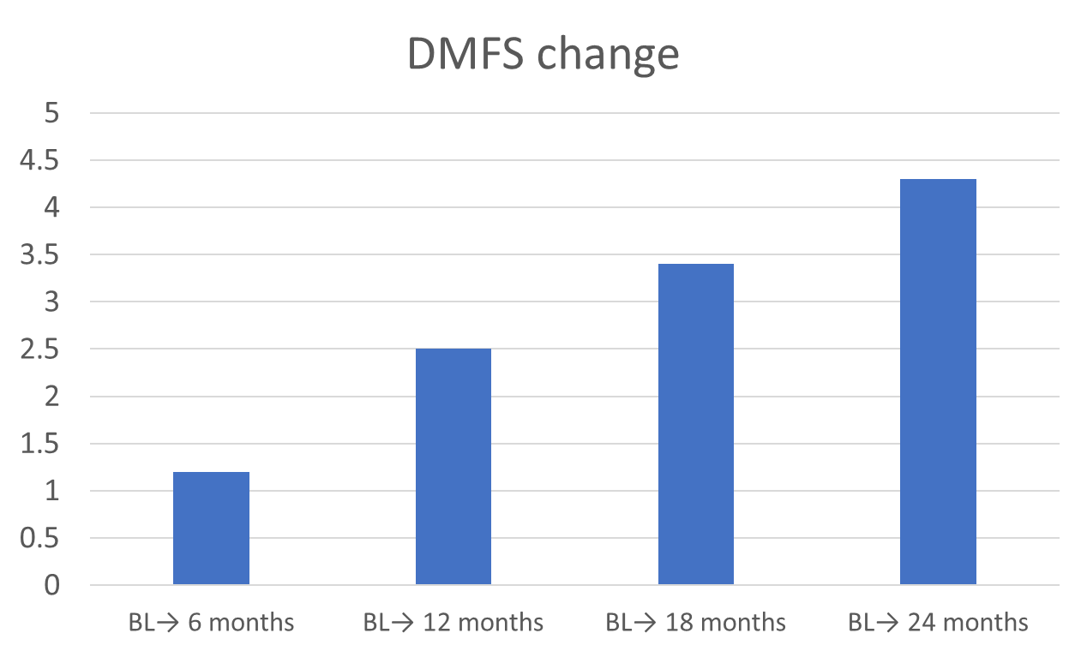
DMFS Change Over Time (OraRad n=572)

Slide 53


DMFS and Compliance
OH compliant at baseline visit (n=222: 43%)
OH non-compliant at baseline visit (n=294: 57%)
OH compliant during follow-up (n=182: 35%) | OH non-compliant during follow-up (n=334: 65%)
136 (61%) | 86 (39%)
46 (16%) | 248 (84%)

Slide 54
ORAD: DMFS – Risk Factors
An increase of DMFS was identified in HNC patients in OraRad and the increase in DMFS was significantly smaller for:
People who are compliant vs. non-compliant with oral hygiene and prescription fluoride
People with greater than high-school education compared to high school or less.
Some key risk factors found not to be associated with DMFS change included having vs. not having dental insurance at baseline; RT dose to parotids and salivary flow rates.
Brennan MT, Treister NS, Sollecito TP, Schmidt BL, Patton LL, Lin A, Elting LS, Helgeson ES, Lalla RV. Dental Caries Postradiotherapy in Head and Neck Cancer. JDR Clin Trans Res. 2023 Jul;8(3):234-243.

Slide 55
Gingival Health and Radiotherapy - ORARAD
RT for HNC leads to mandibular gingival recession, in a dose-dependent manner. This gingival recession may contribute to the increased risk for cervical caries seen in these patients.
Lalla RV, Treister NS, Sollecito TP, Schmidt BL, Patton LL, Helgeson ES, Lin A, Rybczyk C, Dowsett R, Hegde U, Boyd TS, Duplinsky TG, Brennan MT. Radiation therapy for head and neck cancer leads to gingival recession associated with dental caries. Oral Surg Oral Med Oral Pathol Oral Radiol. 2022 May;133(5):539-546.

Slide 56
Risk Factors with Gingival Recession
Baseline Factors - NONE
Cancer and Treatment Factors
Higher mean RT dose to mandible = ↑ gingival recession
Post-RT Factors - NONE

Slide 57
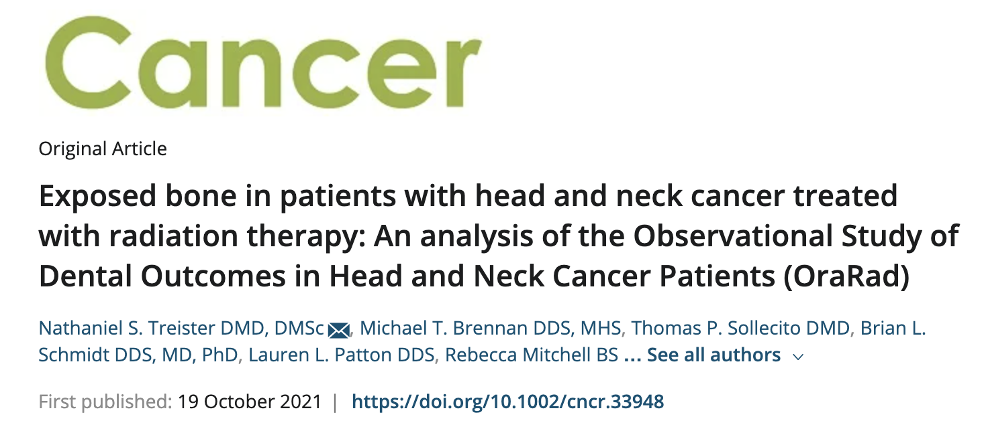
Exposed Bone after XRT

Slide 58
Exposed Bone after XRT
The study enrolled 572 participants;
35 (6.1%) were diagnosed with incident exposed bone at 6 (47% of reports), 12 (24%), 18 (20%), and 24 months (8%),
60% being sequestrum and with 7 cases (20%) persisting for >6 months.
The average maximum RT dose to the affected area of exposed bone was 5456 cGy (SD, 1768 cGy);
Most frequent associated primary RT sites were the oropharynx (42.9%) and oral cavity (31.4%), and
76% of episodes occurred in the mandible.
The diagnosis of ORN was confirmed in 18 participants for an incidence rate of 3.1% (18 of 572).
Risk factors included pre-RT extractions (P = .008),
higher RT dose (P = .039),
tobacco use (P = .048).
The 2-year incidence of exposed bone in the OraRad cohort was 6.1%; the incidence of confirmed ORN was 3.1%.

Slide 59
Future Directions
Main findings from OraRad I
Largest prospective, multicenter cohort studies for HNC
Prospectively identified incidence/prevalence of short and long-term oral and dental complications related to cancer radiation therapies
Identified key risk factors for oral and dental outcomes
Develop a Risk Model Calculator
Improve guidelines for dental management and oral care of HNC patients
Guide future interventional studies to improve the care for HNC patients
Review data at 7 years OraRad II

Slide 60
Acknowledgments- OraRad
Funding by the National Institute for Dental and Craniofacial Research (NIDCR), National Institutes of Health (NIH), United States (1U01DE022939-01).
CMC
Cathleen Petersen
Jenene Noll
Kathleen Sullivan
Marcela Lizano
Michael Carpenter
Jay Davis
U Conn
Rajesh Lalla (co-PI)
Cynthia Rybcyzk
U Penn
Thomas Sollecito (PI)
Alexander Lin
Kim Valentino
Michelle Dattilo
Adam Rose
BWH
Nathaniel Treister (PI)
Lisa Johnson
Lori Giblin
Lori Rainchuso
NYU
Brian Schmidt (PI)
Ismael El Khouly
John Dolan
Culley Makeda
Akapo Adenike
UNC
Lauren Patton (PI)
JoAnn Blakey
Candina Bynum
MD Anderson
Linda Elting
U Minnesota
Jim Hodges
Leslie Long Simpson
Helen Voelker
Rebecca Mitchell
Erika Helgeson
Irene Olson

Slide 61
Partial OraRad References
1. Lalla RV, Long-Simpson L, Hodges JS et al. Clinical registry of dental outcomes in head and neck cancer patients (OraRad): rationale, methods, and recruitment considerations. BMC Oral Health 2017;17:59. doi: 10.1186/s12903-017-0344-y. PubMed PMID: 28241807; PubMed Central PMCID: PMC5327511.
2. Lalla RV, Treister N, Sollecito T, Schmidt B, Patton LL, Mohammadi K, et al. Oral complications at 6 months after radiation therapy for head and neck cancer. Oral Dis. 2017;28(8):1134-43. doi: 10.1111/odi.12710. PubMed PMID: 28675770; PubMed Central PMCID: PMC6218933.
3. Brennan MT, Treister NS, Sollecito TP, Schmidt BL, Patton LL, Mohammadi K, Simpson LL, Voelker H, Hodges JS, Lalla RV, Dental Disease Prior to Radiotherapy in Head and Neck Cancer Patients: Clinical Registry of Dental Outcomes in Head and Neck Cancer Patients (OraRad), J Am Dent Assoc. 2017 Dec; 148(12): 868–877. doi:10.1016/j.adaj.2017.09.011 PubMed PMID: 29173331; PubMed Central PMCID: PMC5777182
4. Mougeot JC, Stevens CB, Almon KG, Paster BJ, Lalla RV, Brennan MT, et al. Caries-associated oral microbiome in head and neck cancer radiation patients: a longitudinal study. J Oral Microbiol. 2019;11(1):1586421. doi: 10.1080/20002297.2019.1586421. PubMed PMID: 30891159; PubMed Central PMCID: PMC6419625.
5. Talevi V, Wen J, Lalla RV, Brennan MT, Mougeot FB, Mougeot JC.Talevi V, et al. Identification of single nucleotide pleomorphisms associated with periodontal disease in head and neck cancer irradiation patients by exome sequencing. Oral Surg Oral Med Oral Pathol Oral Radiol. 2020 Jul;130(1):32-42.e4. doi: 10.1016/j.oooo.2020.02.013. PubMed PMID: 32451231
6. Brennan MT, Treister NS, Sollecito TP, Schmidt BL, Patton LL, Yang Y, Lin A, Elting LS, Hodges JS, Lalla RV. Epidemiologic Factors in Patients with Advanced Head and Neck Cancer Treated with Radiation Therapy. Head Neck. 2021 Jan;43(1):164-172. doi: 10.1002/hed.26468. Epub 2020 Sep 29. PMID: 32991009; PubMed Central PMCID: PMC7756563
7. Lin A, Helgeson ES, Treister NS, Schmidt BL, Patton LL, Elting LS, Lalla RV, Brennan MT, Sollecito TP. The impact of head and neck radiotherapy on salivary flow and quality of life: Results of the ORARAD study. Oral Oncol. 2022 Feb 26;127:105783. doi: 10.1016/j.oraloncology.2022.105783. PMID: 35231809
8. Treister NS, Brennan MT, Sollecito TP, Schmidt BL, Patton LL, Mitchell R, Haddad RI, Tishler RB, Lin A, Shadick R, Hodges JS, Lalla RV. Exposed bone in patients with head and neck cancer treated with radiation therapy: An analysis of the Observational Study of Dental Outcomes in Head and Neck Cancer Patients (OraRad). Cancer. 2022 Feb 1;128(3):487-496. doi: 10.1002/cncr.33948. Epub 2021 Oct 19. PMID: 34665873
9. Mougeot JC, Beckman MF, Langdon HC, Lalla RV, Brennan MT, Bahrani Mougeot FK. Haemophilus pittmaniae and Leptotrichia spp. Constitute a Multi-Marker Signature in a Cohort of Human Papillomavirus-Positive Head and Neck Cancer Patients. Front Microbiol. 2022 Jan 18;12:794546. doi: 10.3389/fmicb.2021.794546. eCollection 2021. PMID: 35116012
10. Ward MC, Carpenter MD, Noll J, Carrizosa D, Moeller BJ, Helgeson ES, Lalla RV, Brennan MT. Oncologists' Perspective on Dental Care Around the Treatment of Head and Neck Cancer: A Pattern of Practice Survey. JCO Oncol Pract. 2022 Jan;18(1):e28-e35. doi: 10.1200/OP.20.00913. Epub 2021 Jul 9. PMID: 34242067
11. Brennan MT, Treister NS, Sollecito TP, Schmidt BL, Patton LL, Lin A, Elting LS, Hodges JS, Lalla RV. Tooth Failure Post-Radiotherapy in Head and Neck Cancer: Primary Report of the Clinical Registry of Dental Outcomes in Head and Neck Cancer Patients (OraRad) Study. Int J Radiat Oncol Biol Phys. 2022 Jun 1;113(2):320-330. doi: 10.1016/j.ijrobp.2021.11.021. Epub 2021 Dec 5. PubMed PMID: 34879248; PubMed Central PMCID: PMC9159492.
12. Lalla RV, Treister NS, Sollecito TP, Schmidt BL, Patton LL, Helgeson ES, Lin A, Rybczyk C, Dowsett R, Hegde U, Boyd TS, Duplinsky TG, Brennan MT. Radiation therapy for head and neck cancer leads to gingival recession associated with dental caries. Oral Surg Oral Med Oral Pathol Oral Radiol. 2022 May;133(5):539-546. doi: 10.1016/j.oooo.2022.01.016. Epub 2022 Jan 31. PubMed PMID: 35304084; PubMed Central PMCID: PMC9018549.

Slide 62
13. Lalla RV, Brennan MT. Dental Management of Patients Receiving Radiation Therapy for Head and Neck Cancer: Updates from the OraRad Study. Decisions in Dentistry. 2022
14. Brennan MT, Treister NS, Sollecito TP, Schmidt BL, Patton LL, Lin A, Elting LS, Helgeson ES, Lalla RV. Dental Caries Postradiotherapy in Head and Neck Cancer. JDR Clin Trans Res. 2022 Apr 11;:23800844221086563. doi: 10.1177/23800844221086563. [Epub ahead of print] PubMed PMID: 35403479.
15. Threet EJ, Napeñas JJ, Petersen C, Mitchell R, Long-Simpson L, Shadick R, Valentino KC, Rybczyk CA, Blake JA, Brown MC, Aidoo R, Helgeson ES, Lalla RV, Brennan MT. Survey of experiences and barriers to dental care post-head and neck cancer in OraRad study participants. Oral Surg Oral Med Oral Pathol Oral Radiol. 2023 Apr;135(4):501-509. doi: 10.1016/j.oooo.2022.11.011. Epub 2022 Dec 13. PubMed PMID: 36717342; PubMed Central PMCID: PMC10101878.
16. Lalla RV, Brennan MT. Strategies to support patients undergoing radiation therapy. Dimensions of Dental Hygiene. 2023 Mar; 21(3)42-45.
17. Lalla RV, Hodges JS, Triester NS, Sollecito TP, Schmidt BL, Patton LL, Lin A, Brennan MT. Tooth-level predictors of tooth loss and exposed bone after radiation therapy for head and neck cancer. J Am Dent Assoc. 2023 Jun;154(6):519-528.e4. doi: 10.1016/j.adaj.2023.03.009. PMID: 37236706
18. Patton LL, Helgeson ES, Brennan MT, Triester NS, Sollecito TP, Schmidt BL, Lin A, Bhishamjit SC, Lalla RV. Oral health-related quality of life after radiation therapy for head and neck cancer: the OraRad study. Support Care Can. 2023 Apr 20;31(5):286. doi: 10.1007/s00520-023-07750-2. PMID: 37079106
19. Lim J, Helgeson ES, Lalla RV, Sollecito TP, Treister NS, Schmidt BL, Patton LL, Milas ZL, Brennan MT. Factors associated with oral hygiene compliance in patients treated with radiation therapy for head and neck cancer. J Am Dent Assoc. 2024 Apr;155(4):319-328.e2. doi: 10.1016/j.adaj.2023.11.018. Epub 2024 Mar 7.PMID: 38456849
20. Sollecito TP, Helgeson ES, Lalla RV, Treister NS, Schmidt BL, Patton LL, Lin A, Brennan MT. Reduced mouth opening in patients with head and neck cancer treated with radiation therapy: an analysis of the Clinical Registry of Dental Outcomes in Head and Neck Cancer Patients (OraRad). Oral Surg Oral Med Oral Pathol Oral Radiol. 2024 Mar;137(3):264-273. doi: 10.1016/j.oooo.2023.11.012. Epub 2023 Nov 26.PMID: 38262773
21. Lalla RV, Helgeson ES, Virk K, Lu H, Treister NS, Sollecito TP, Schmidt BL, Patton LL, Lin A, Brennan MT. Females have lower salivary flow than males, before and after radiation therapy for head/neck cancer. Oral Dis. 2024 Jul 15. doi: 10.1111/odi.15068. Online ahead of print.PMID: 39005202
22. Richards ME, Brennan MT. Chronic Oral Complications of Oral Cancer Therapy. Dent Clin North Am. 2025 Jul;69(3):419-436. doi: 10.1016/j.cden.2025.03.005. Epub 2025 Apr 25.PMID: 40545333
23. Rose AM, Helgeson ES, Valentino KC, Lalla RV, Treister NS, Schmidt BL, Patton LL, Lin A, Brennan MT, Sollecito TP. The impact of medications on salivary flow and oral health-related quality of life in postradiation head and neck cancer patients: results of the OraRad study. Oral Surg Oral Med Oral Pathol Oral Radiol. 2025 Jul 5:S2212-4403(25)01119-8. doi: 10.1016/j.oooo.2025.06.019. Online ahead of print.PMID: 40784870

